Slide 1
ANNUAL REPORT 2020

Slide 3
Our Vision
Stronger, well informed, healthier and self-sustaining communities in Ghana.
Our Mission
To accelerate community development in the areas of health, education and income generation through collaborative efforts of all stakeholders.
Making quality education accessible to all children
Promoting sustainable income
Promoting Sanitation & Hygiene

Slide 4
Letter of the President of the Governing Council

Slide 5
Letter from the Acting Executive Director

Slide 6
Our Partners
Sankofa Beach House

Slide 7
Our Impact in Numbers

Slide 8
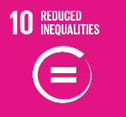
Education Projects
Due to the COVID 19 pandemic basic school young learners were home as a result of the school closure, United Way Ghana developed the Home Literacy Program to support young learners who would have otherwise missed out on available virtual learning opportunities, each child that was engaged received a literacy booklet.
We also donated 328 literacy booklets to one of our basic schools to support the school’s literacy program the teachers were running voluntarily. In total, we supported 3,929 young learners from beneficiary communities.
The young learners were engaged in homes by trained volunteers and virtually by employee volunteers.
We incorporated the use of a literacy App, the KitKit School, into this project to get the young learners acquainted with digital learning, “Kitkit School is a tablet-based application with a comprehensive curriculum that spans early childhood through early elementary. It is designed to provide children with the fundamentals and practice needed to build foundational skills in literacy and numeracy, even without access to school or resources, we conducted a pre-project assessment to identify the children’s reading ability to enable us measure the impact at the end.
With support from trained volunteers and implementing partners, we engage the young learners for at least 4 hours a week. We use customized developed literacy booklets that the young learners can relate to and that inspires them to read.
Our Partners

Slide 9
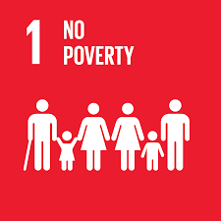
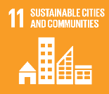
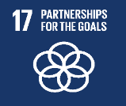
Health Projects
Food security became a major issue in Ghana during the lock down. Though the restrictions were reduced, families that were greatly affected were unable to recover immediately.
Food security became a major issue in Ghana during the lock down. Though the restrictions were reduced, families that were greatly affected were unable to recover immediately.
United Way Ghana in collaboration with community based organizations, community leaders and community members who were engaged as volunteers was able to identify such families to benefit from the food distribution project.
United Way Ghana in collaboration with community based organizations, community leaders and community members who were engaged as volunteers was able to identify such families to benefit from the food distribution project.

Slide 10
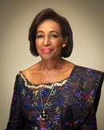
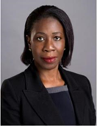
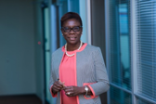
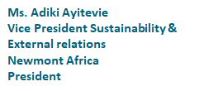
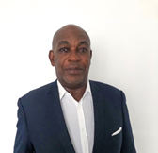
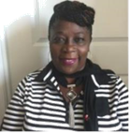
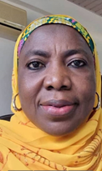
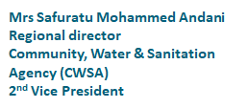
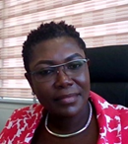
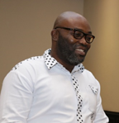

Slide 11
Faustina Abbey - Impact Lead
Mary Thompson - Operations Assistant
Grace Braimah - Community Coordinator (Greater Accra, Central & Eastern Region)
Robert Mills - Project Lead (Adult & Youth Financial Empowerment)
Kwame Benson - Project Lead (Education)
Moses Gyasi - Community Coordinator (Ashanti Region)
Faisel Ishak - Intern

